Slide 1
Movie Predictions
By: The Paramount Predictors
Rebecca Melo and Michaela Giandello

Slide 2
Table of Contents
A
Summary
B
Machine Learning Models
C
Dashboard
D
Conclusion/Questions

Slide 3
Summary
1980 - 2022
The Data
Using movie data from over 40 years
Train data = movies over 40 years
Test data = all known upcoming movies
Features
Conclusion
Movie Rating, Genre, Director, Writer, Actor/Star, Box Office/Gross, Runtime, IMDB Score, Meta-Score
Our models need more data :(

Slide 4
Our Story
New movies, like The Batman starring Robert Pattinson and Zoë Kravitz, has made $128.5 million domestic opening weekend of March 3rd, making it the second-best pandemic opener behind Spider-Man: No Way Home. Can we create a model that can be used to predict a range of box office earnings and imdb scores for future debuts?
Our thought process was:
Can We Predict Box Office Gross Revenue?
1
With Logistic Regression, Random Forest, etc?
Can We Predict IMDb Score ratings?
2
With Logistic Regression, Random Forest, etc?
Can We Predict Anything Else?
3
Is there enough data to predict other movie features?

Slide 5
Data Types Used
Web Scraping
IMBD.com and the-numbers.com
Machine Learning
API
Pandas, Numpy, Sklearn, Matplotlib, Logistic Regression, RandomForest Classifier
OMBD database
Database
Dashboard
PostgreSQL
Heroku
HTML, CSS, Javascript, Bootstrap, Flask

Slide 6

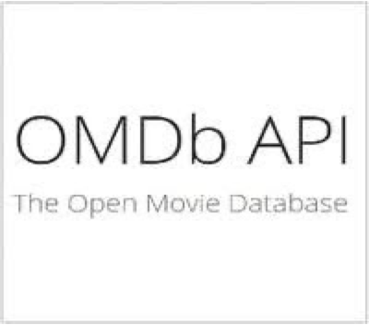




Extract, Transform, Load
Extract Part 1
Extract Part 3
Load
Find as much Historical Domestic Box Office Information (1980-2022)
Scrape IMDB upcoming movie list and use OMDB to find any info out there
Loaded tables to PostrgresSQL. Use Flask & Heroku for hosting website
Jupyter Notebook
OMBDapi.com
IMDb
PostgreSQL & Heroku
Web Scraping The-Numbers.com
& Kaggle CSV
Extract Part 2
Transform
Use API from OMDB and get all info from scrapped list
Jupyter Notebook to clean merge data Historical and Upcoming Lists

Slide 7
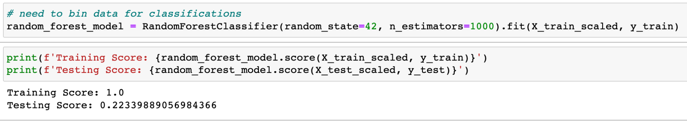
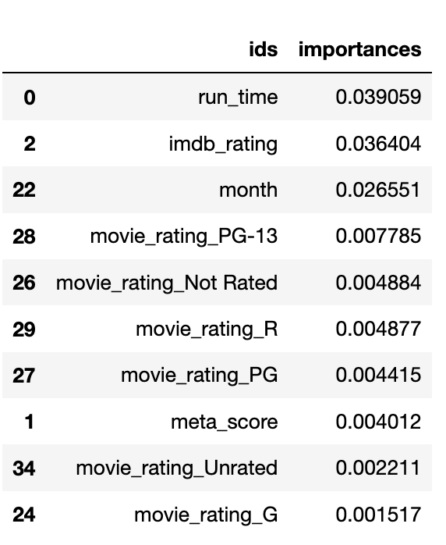
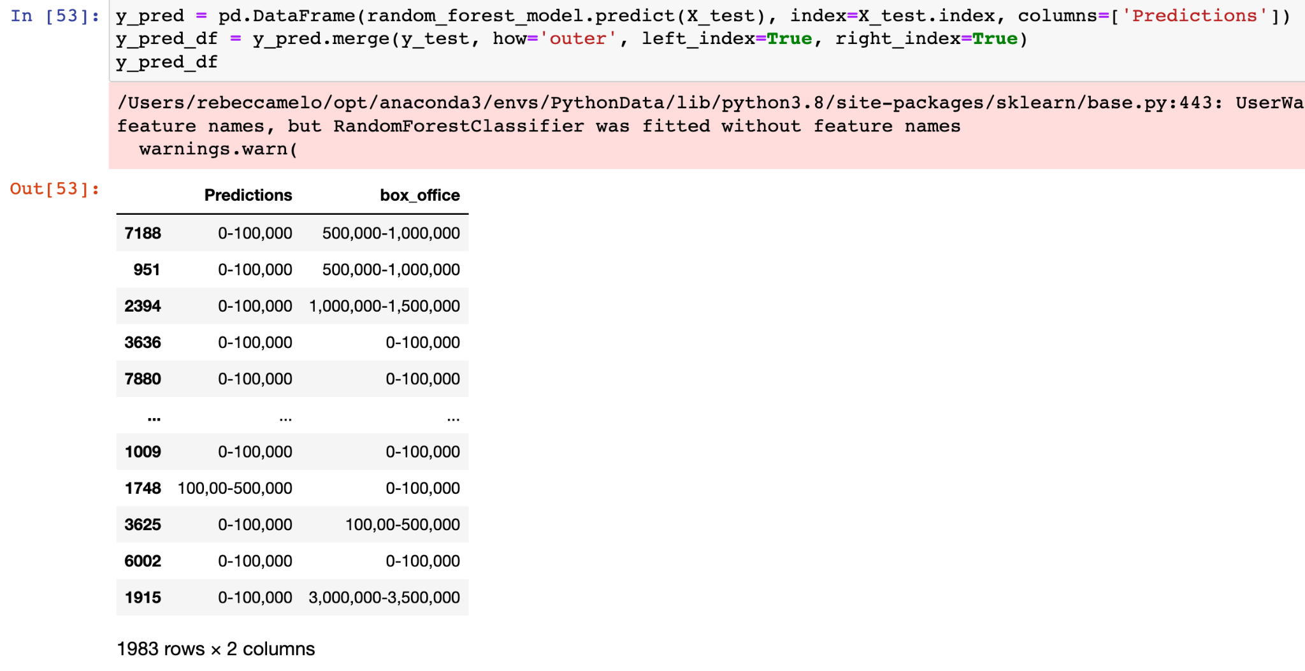
Machine Learning Models - Random Forest Classifier for Box Office
Creation of our models went through several iterations
We knew we wanted to use Supervised Learning vs Unsupervised.
First started with Random Forest Classifier
Features included:
Movie Rating
Release Date
Run time
Meta Score
IMDb rating
Box Office (Gross)
Director
Writer
Actor
Outcome:
Training Test Score were very off and LOW which in term incorrectly predicted Box Office numbers from Prediction VS. Actual
Importance weights on features were very low
Need more features to use this type of model properly

Slide 8
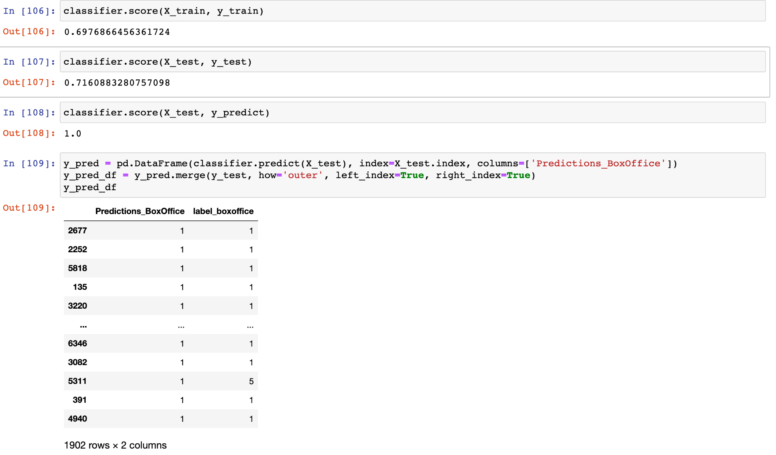
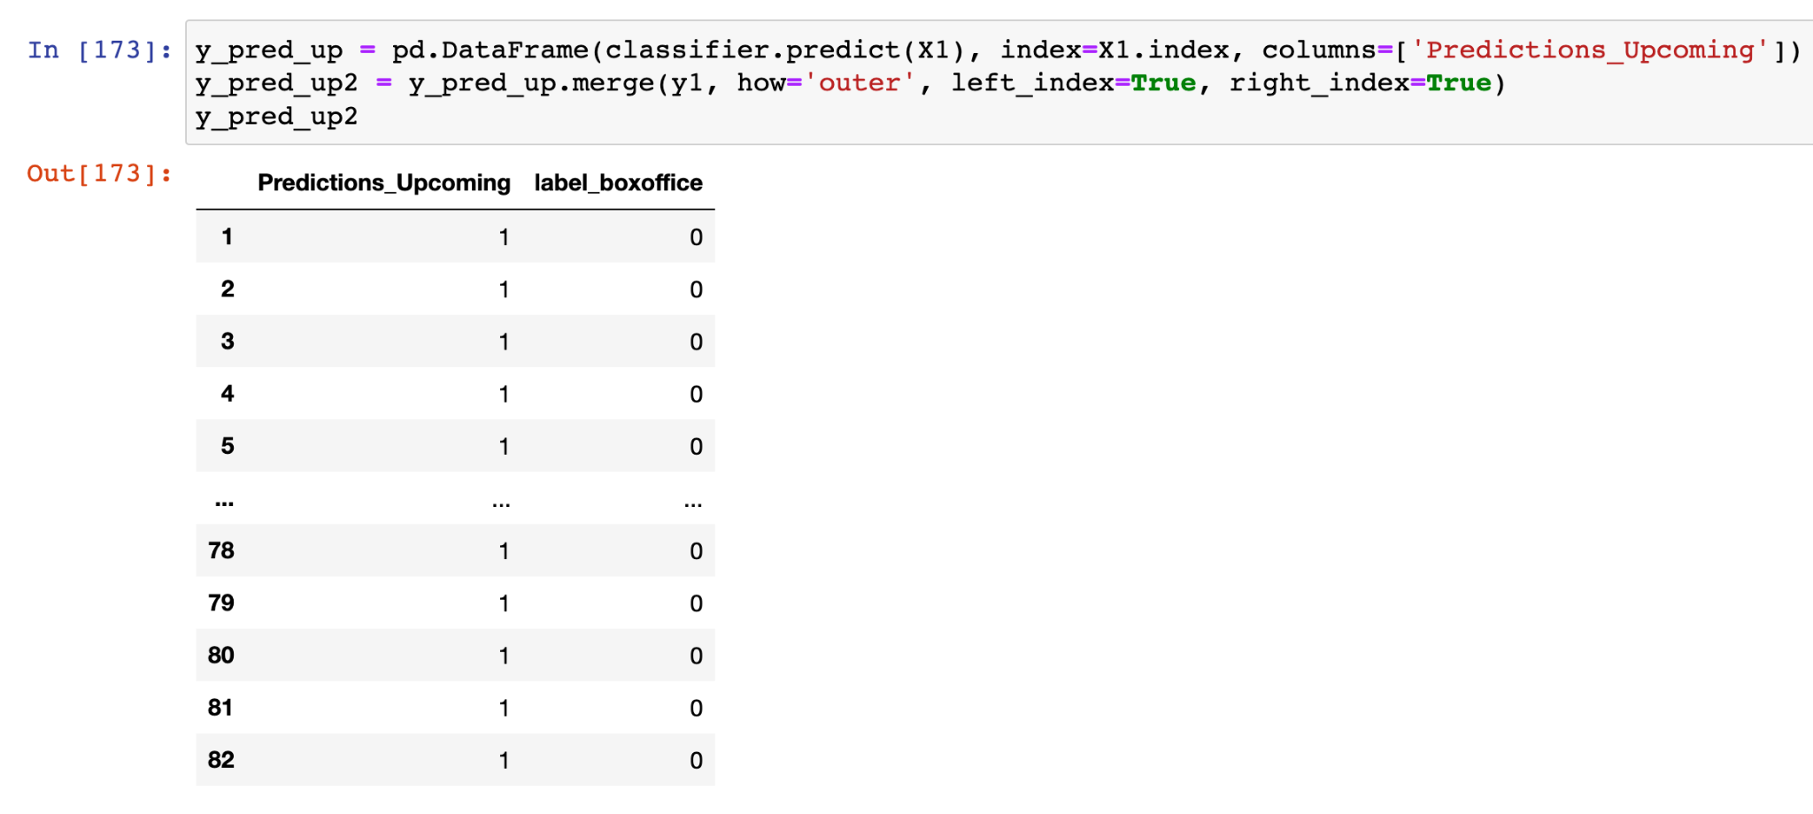
Machine Learning Models - Logistic Regression for Box Office
Next we moved on to Logistic Regression
Same features
Outcome:
Training and Test Score were better than Random Forest, in the low 70s for accuracy
Predictions for Box Office numbers from Prediction VS. Actual were still off
In the end, we still need more features to use this type of model properly, like budget, marketing, etc.

Slide 9
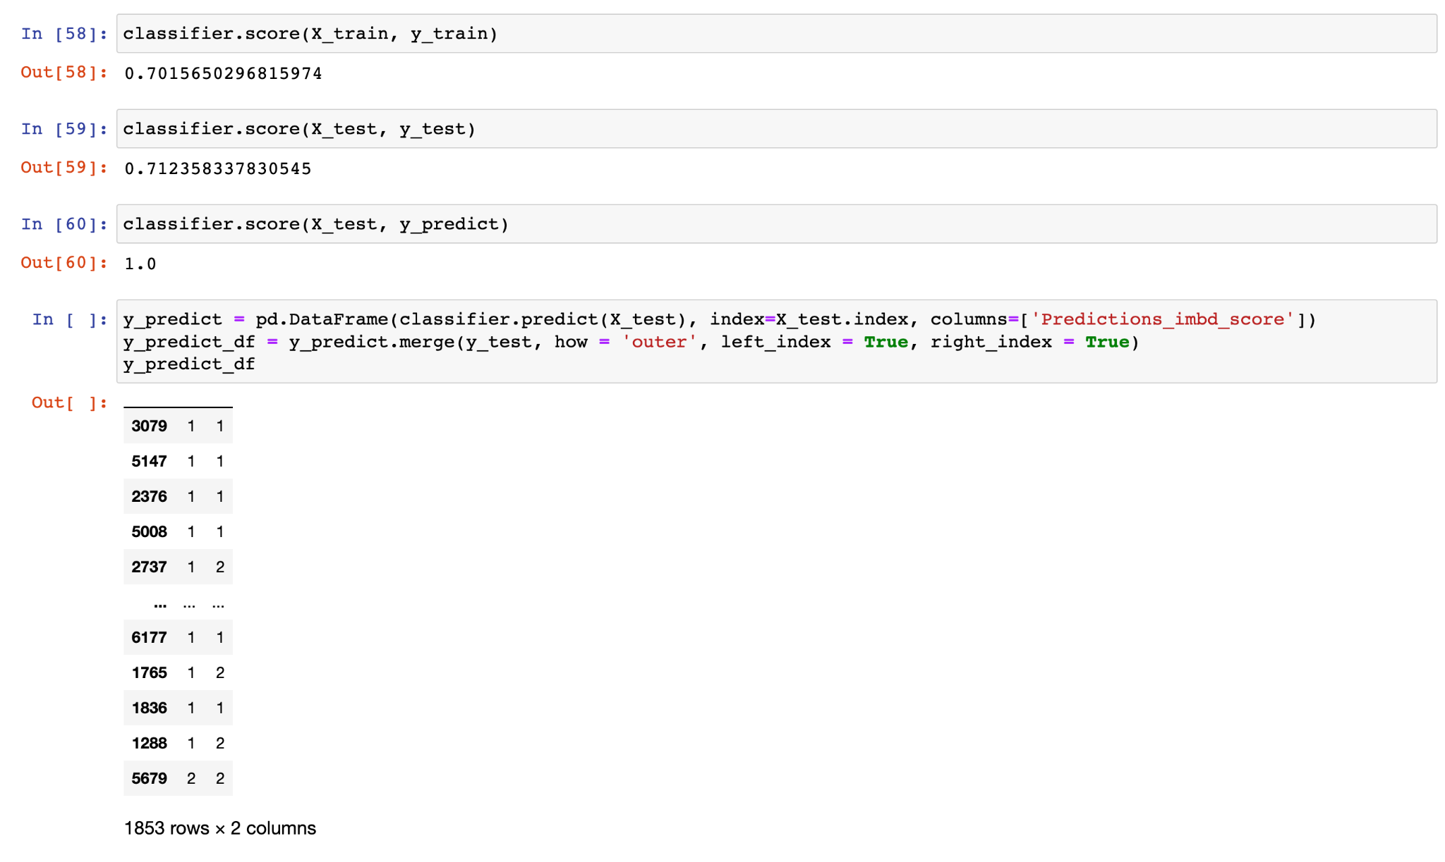
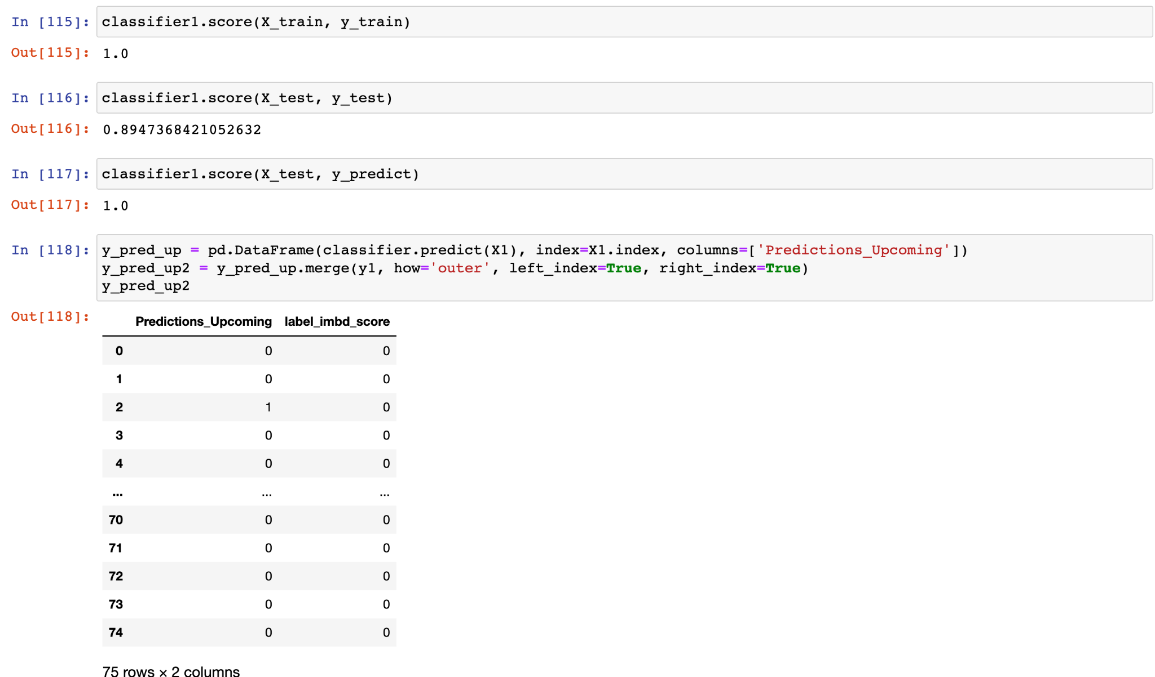
Machine Learning Models - Logistic Regression for IMDb Rating
We then tried Logistic Regression for IMDb ratings
Same features
Outcome:
Training and Test Score was ok, lower than expected, and around the same low 70% accuracy as the Box Office model was for Logistic Regression
The predicted for Box Office numbers from Prediction VS. Actual were still off; kind of the same way the Box Office was
In the end, we still need more features to use this type of model properly
Train Historical Movie List vs. Test Upcoming Movie List

Slide 10
Limitations, Issues and Next Steps
1
Limitations
Film financial data is guarded by the industry. It is difficult to find accurate and reliable, publicly available information.
2
Issues
- Settling on a model
- Paywalls if we wanted to find more features to add to our data frame
3
Next Steps
Look to see where we can find more data, look more deep into the-number.com website and see if we can scrape more data there

Slide 11
Questions?

Slide 12
Let’s Go To Our Webpage!

